Slide 1
College Trigonometry
Barnett/Ziegler/Byleen
Chapter 5

Slide 2
Chapter 5 – section 1
Inverse trig functions

Slide 3
Inverse of a function
The inverse of a function is the relation that connects the range back to the domain
g(x) is the inverse of f(x) then g(f(x)) = x
The notation for inverse function is a -1 exponent on the function name
sin⁻¹(x) cos⁻¹(x) tan⁻¹(x) etc
Note this is NOT the same as reciprocals although the notation is similar

Slide 4
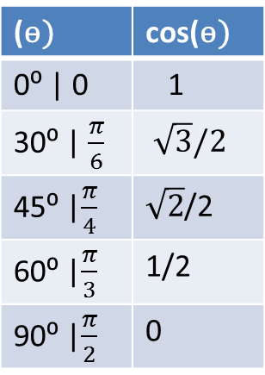
Inverse: Given output what was input
Find cos⁻¹(1/2)
find cos⁻¹(cos(0))
(ө) | cos(ө)
0⁰ | 0 | 1
30⁰ | $\frac{π}{6}$ | $\sqrt{3}/2$
45⁰ |$\frac{π}{4}$ | $\sqrt{2}$/2
60⁰ |$\frac{π}{3}$ | 1/2
90⁰ |$\frac{π}{2}$ | 0

Slide 5
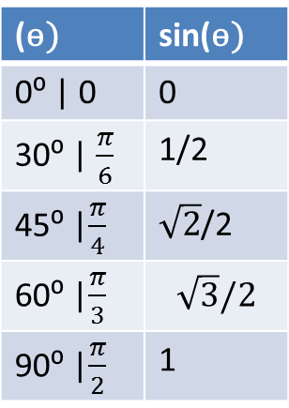
Inverse: Given output what was input
find sin ⁻¹ ($\frac{\sqrt{3}}{2}$ )
find sin⁻¹(sin(π/3))
(ө) | sin(ө)
0⁰ | 0 | 0
30⁰ | $\frac{π}{6}$ | 1/2
45⁰ |$\frac{π}{4}$ | $\sqrt{2}$/2
60⁰ |$\frac{π}{3}$ | $$\sqrt{3}/2$$
90⁰ |$\frac{π}{2}$ | 1

Slide 6
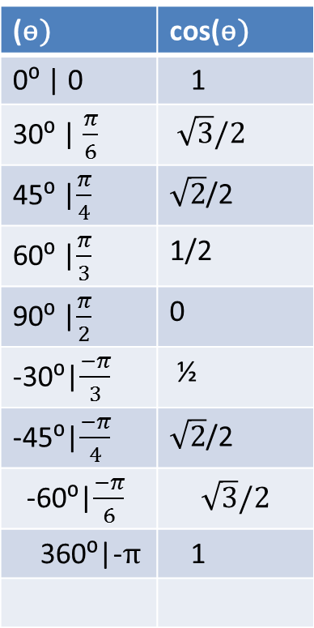
The inverse of a function is not always a function itself
(ө) | cos(ө)
0⁰ | 0 | 1
30⁰ | $\frac{π}{6}$ | $\sqrt{3}/2$
45⁰ |$\frac{π}{4}$ | $\sqrt{2}$/2
60⁰ |$\frac{π}{3}$ | 1/2
90⁰ |$\frac{π}{2}$ | 0
-30⁰|$\frac{−π}{3}$ | ½
-45⁰|$\frac{−π}{4}$ | $\sqrt{2}$/2
-60⁰|$\frac{−π}{6}$ | $$\sqrt{3}/2$$
360⁰|-π | 1
When the inverse of a
function is a function
the functions are called
one to one functions
Trig functions are NOT
one to one
This makes them difficult to
work with

Slide 7
Constraints on inverses
To make functions one to one you restrict their domains and ranges in such a way as to make the domain of the first function the same as the range of its inverse and to have all values of the range covered by the domain of the inverse

Slide 8
Graph of cos(x)= y

Slide 9
Graph of the cos⁻¹(x)

Slide 10
Restrictions forced by inverse
cos(x) for domain 0< x < π
range -1 < y < 1
cos⁻¹(x) with domain of -1<x<1
range 0< y< π
find cos⁻¹(cos(4)) ??????

Slide 11
sin(x) and sin⁻¹(x)
restrict the domain of sin(x) to -π/2<x<π/2
This restricts the range of sin⁻¹(x)

Slide 12
tan(x) and tan⁻¹(x)
Restrict the domain of tan(x) to -π/2<x<π/2
the range is not restricted
therefore the domain of arctan(x) is not restricted but its range is restricted to
-π/2< y <π/2

Slide 13
Estimate with a calculator
arcsin(-.234)
arccos(-1.5)
arctan(cos(4))

Slide 14

Find without a calculator if possible special angles
cos⁻¹($\frac{\sqrt{2}}{2}$ ) arcsin(-1/2)
tan(arccos(1/2))
cos(arctan(3/4))

Slide 15
Assignment
P 302(11-24,27-46)

Slide 16
Chapter 5 – section 2
Inverse sec, csc, cot

Slide 17
arcsec(x)
sec(x) restrict domain to 0<x<π
and x ≠ π/2
range is y<-1 or y > 1
arcsec(x) domain x<-1 or x> 1
range is 0< y<π
and y≠ π/2

Slide 18
arccsc(x)
csc(x) restrict domain to -π/2<x<π/2
x≠0
range is y<-1 or y>1
sooo
arccsc(x) has a domain of x<-1 or x> 1
with range of -π/2<y<π/2
y≠0

Slide 19
arccot(x)
cot(x) with domain restricted to 0<x<π
x ≠π/2
range is unrestricted
arccot(x) has an unrestricted domain
with range restricted to 0<y<π
y ≠π/2

Slide 20
Examples

Slide 21
Using a calculator to estimate inverses with cot, sec, csc
The following identities allow you to find

Slide 22
Assignment
P313(5-70 odd)

Slide 23
Chapter 5 – section 3
Solving trigonometric equations – algebraic approach

Slide 24
Basic algebraic approach
Isolate the variable using inverses and reversing the order of operations
Use factoring or roots to reduce the power on the variable taking care to account for any sign issues
Take into account ALL restrictions to both domain and ranges for ALL functions in the equation

Slide 25
Dealing with range restriction
When requested to solve an equation you are being asked to find ALL numbers that make the statement true.
Since trig functions are periodic any one solution produces a repeating pattern of solutions that are exactly one period apart.
For sin and cos (sec and csc) there is also a second solution associated with a reference angle that is in another quadrant and this solution also produces a repeating pattern of solutions that are one period apart

Slide 26
Basic examples
sin(x) = $\frac{\sqrt{3}}{2}$
algebraically x = arcsin$\left(\frac{\sqrt{3}}{2}\right)$
Since arcsin is a function this produces a single value of $\frac{π}{6}$ therefore $\frac{π}{6}+2π$ is a solution
and $\frac{π}{6}+2π+2π$ is also a solution
we can state this as $\frac{π}{6}+2nπ$ with n $∈integers$
utilizing the unit circle we obtain a second solution of $\frac{5π}{6}$ and similarly obtain $\frac{5π}{6}+2nπ$ with n $∈integers$
So the solution is stated as :

Slide 27
example
find all solutions to
tan(x) = 3.4
x = arctan(3.4)
solution Set arctan(3.4) + nπ
estimated solutions: 1.23 + nπ

Slide 28
Example
Find all solutions for 0 < x < 2π
cos(x) =0 .8
x = arccos(0.8) ≈0.6416
Utilize the unit circle to find the second solution:
x = - 0.6416 is the easiest reference angle but it is not in the stated domain
Utilize + 2π to find the solution that is in the state solution x = 6.9248

Slide 29
Using algebra to solve more complicated problems
$\sqrt{3}\tan\left(x\right)+1=0$
Use basic algebra to isolate tan(x)
tan(x) = $−\frac{1}{\sqrt{3}}$
x = $\tan^{−1}\left(−\frac{1}{\sqrt{3}}\right)=−\frac{π}{6}$
answer is: $−\frac{π}{6}+nπ$
which can be written as $\frac{5π}{6}+nπ$

Slide 30
Other algebra tricks
solve for all real values
6cos²(x) + 5cos(x) + 1 = 0
6u2 + u – 1 = 0
(3u - 1)(2u + 1)= 0
u = 1/3 or u = -1/2
so cos(x) = 1/3 or cos(x) = - 1/2

Slide 31
Using trig identities
2cos²(x) – 3sin²(x) = 0
0⁰ < x < 360⁰
sin(x)≈± 0.6325

Slide 32
Example
2sin²(x) + 3 cos(x) = 0

Slide 33
Assignment
P324 (5-56 odd 63,65,67)

